Slide 1















Slide 2

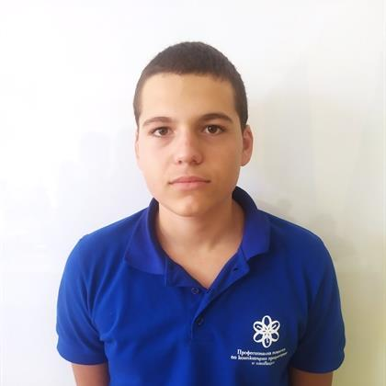
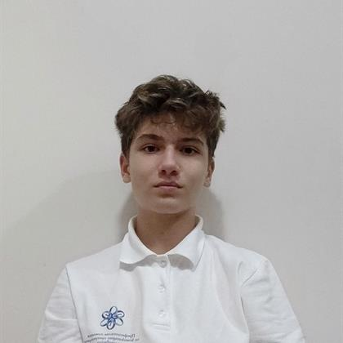
Our team
Todor Atanasov
Aleks Kazakov
Front-end developer
Back-end developer

Slide 3



The plan!

Slide 4
Business plan

Slide 5









Technology stack

Slide 6
Let’s jump to the code!

